Slide 1

Business Intelligence dashboard
Powered by .

Slide 2
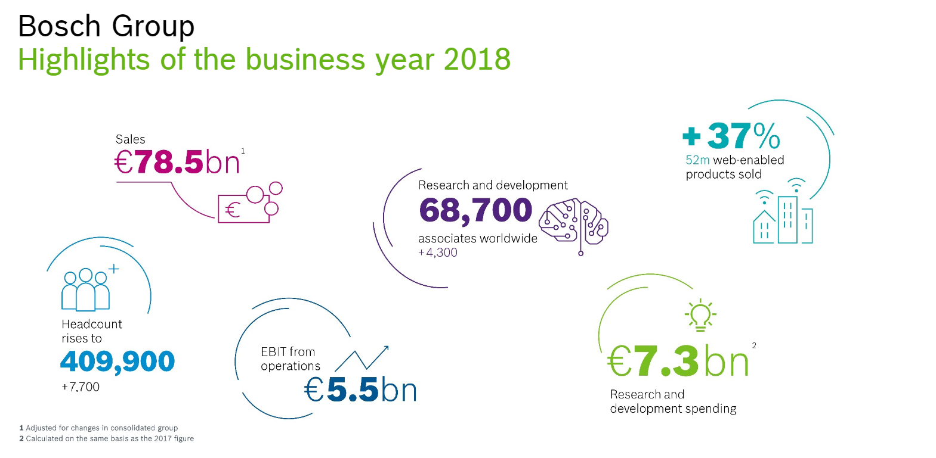

Slide 3
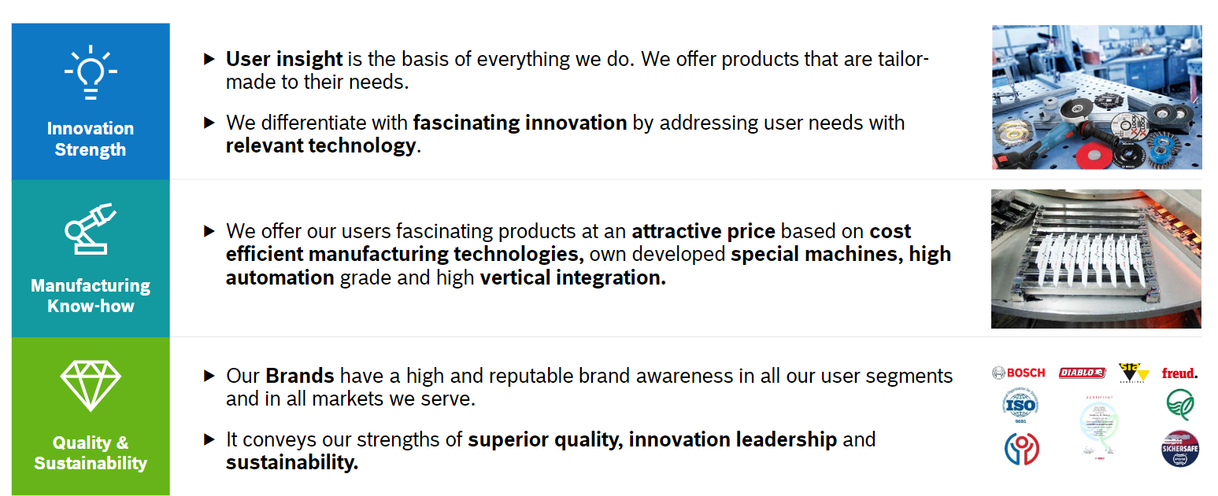
Mission: „The Power Tools division is one of the world’s leading providers for power tools, power tool accessories and measuring tools.“

Slide 4
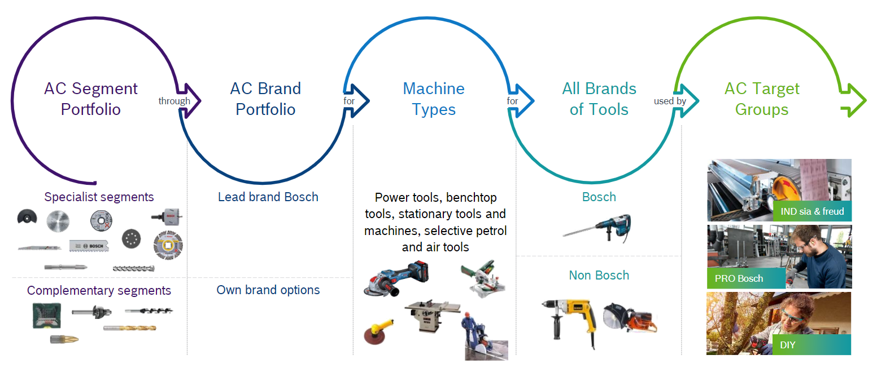
Power Tools Accessories Business strategy

Slide 5
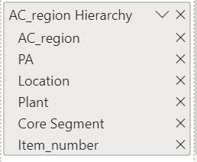
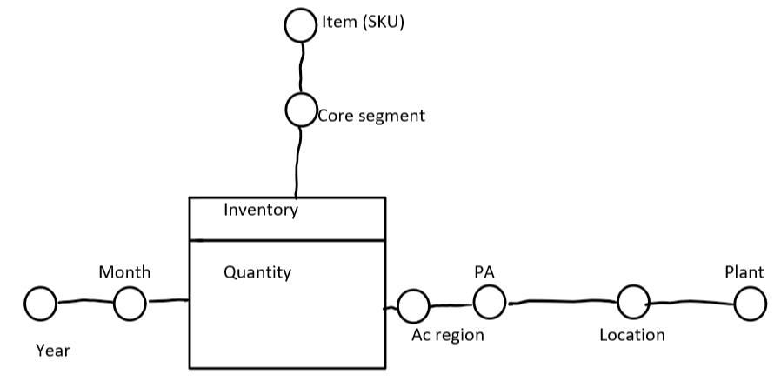
Main KPIs and hierarchy set up
Inventory MoM (month over month) change MoM= (inventory value in May)- (inventory value in June). Stakeholders can see improvement from MoM
Stock value in Month
Using the Hierarchy model to be able to go deeper to identify the problem.

Slide 6
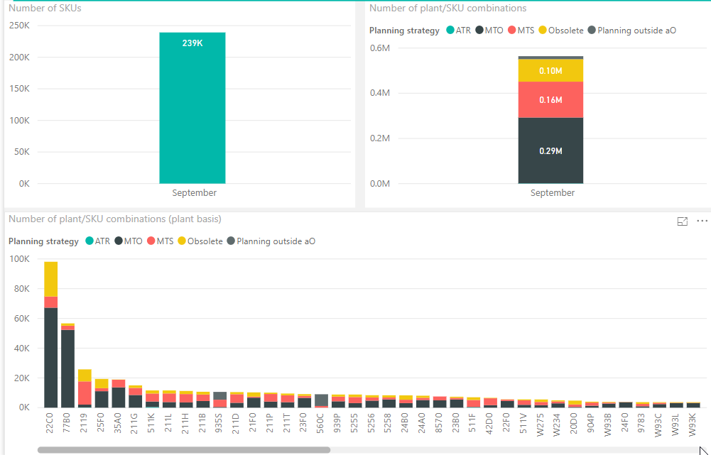
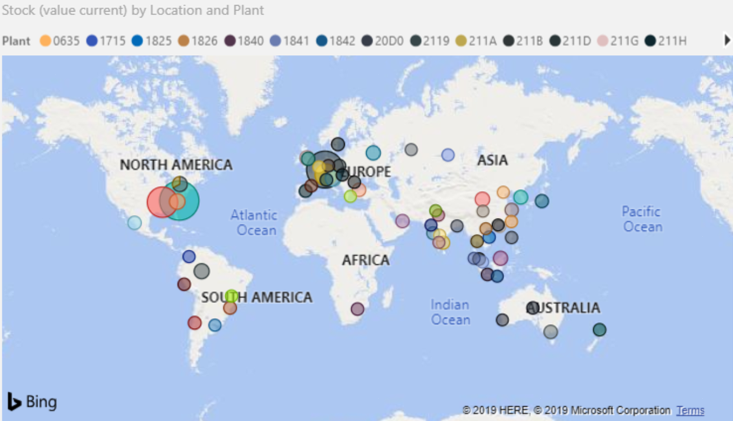
Dashboard development
Organize and present the existent data:
Support Business Decisions with Global inventory overview,
Support Warehouse/Inventory management
Fast Global inventor overview
Visualize each SKUs where they belongs to in the Planning strategy group

